Slide 1
K-W-L & The More You Know
Demo

Slide 2
Welcome to the DEMO of
K-W-L & The More You Know.
You will see that it has all three layers of reading. We put it in the BEFORE category because that is where most of the action takes place.
Now let’s go to the ThinkSheet for this Strategy.
Before going on, read the pages in the handbook: Activate Prior Knowledge and Build Schema and the strategy KWL & The More You Know.

Slide 3
Notice the BEFORE,

Slide 4
the DURING,

Slide 5
and the AFTER parts of this strategy.

Slide 6
Although this is definitely a B, D, and A strategy, we categorize it with BEFORE strategies to emphasize the importance of activating prior knowledge before doing academic reading.

Slide 7
However, if you realize after previewing that some concepts are absolutely foreign to you, doing The More You Know for a few of these concepts BEFORE reading will give you a head start in learning from this text.
Building schema (The More You Know part of the strategy) is also vital for learning from a text and will usually take place during the DURING and AFTER parts of the strategy.
.

Slide 8
First, I will introduce you to the text I will be using with this strategy.

Slide 9
Chapter 17 of the Physical Science Foundations, entitled:

Slide 10
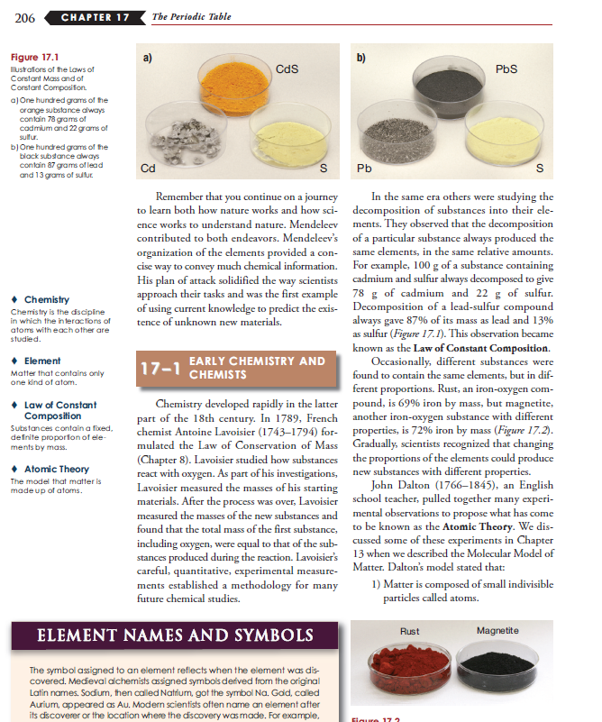
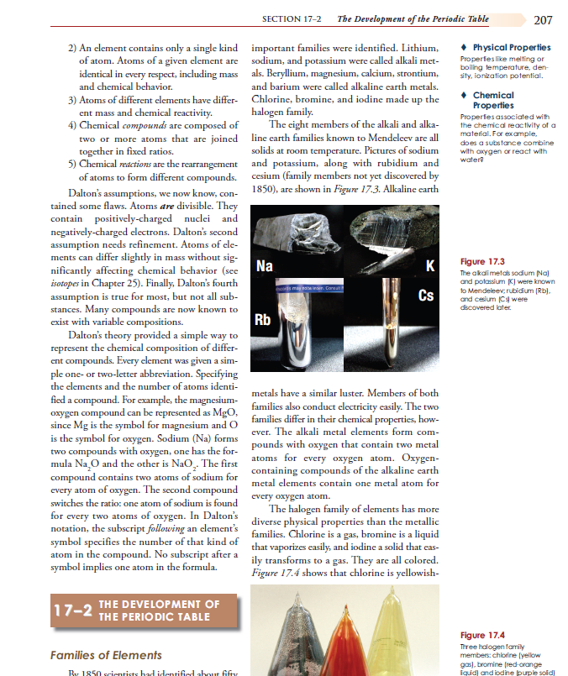
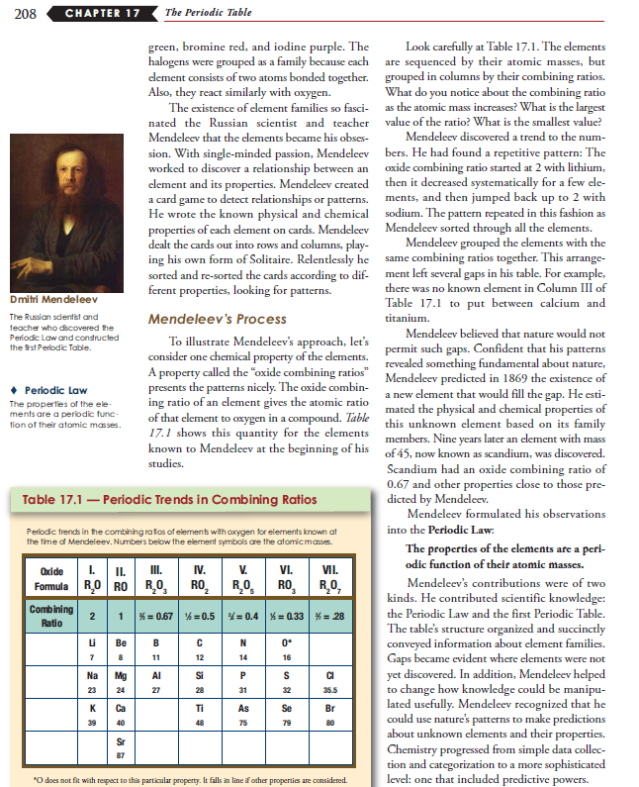
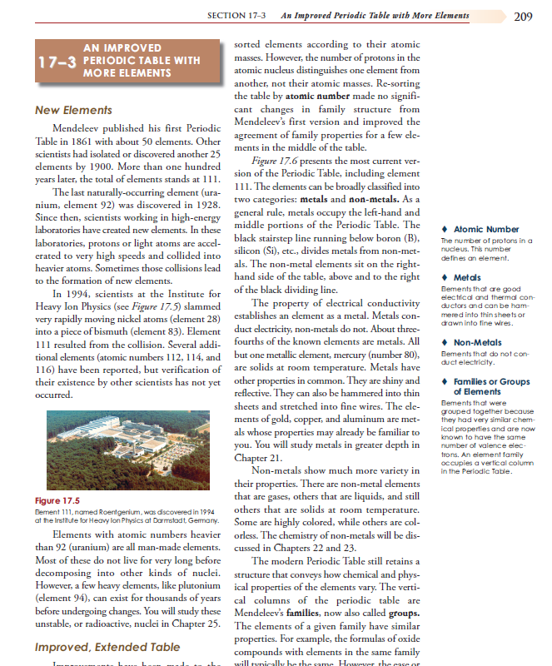
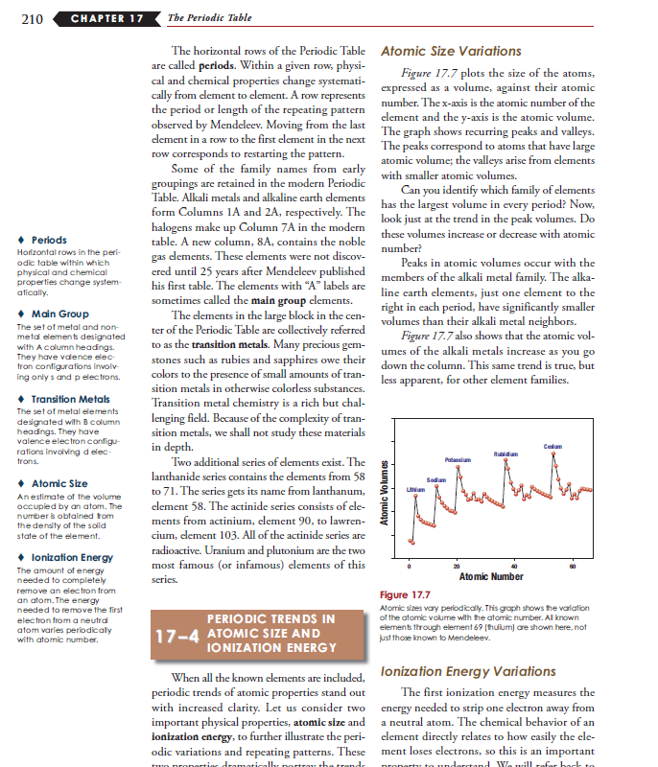
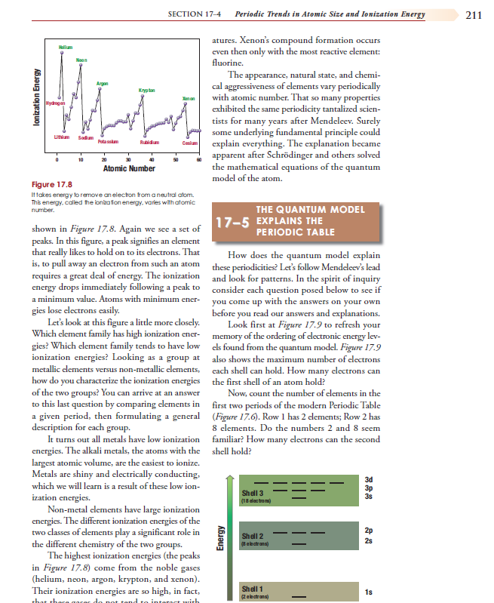
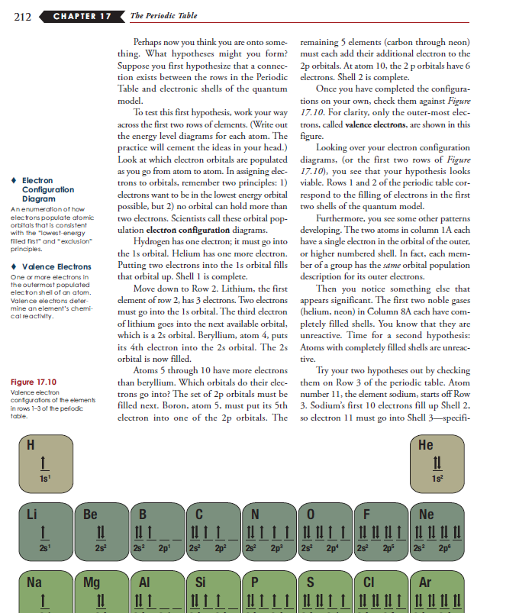
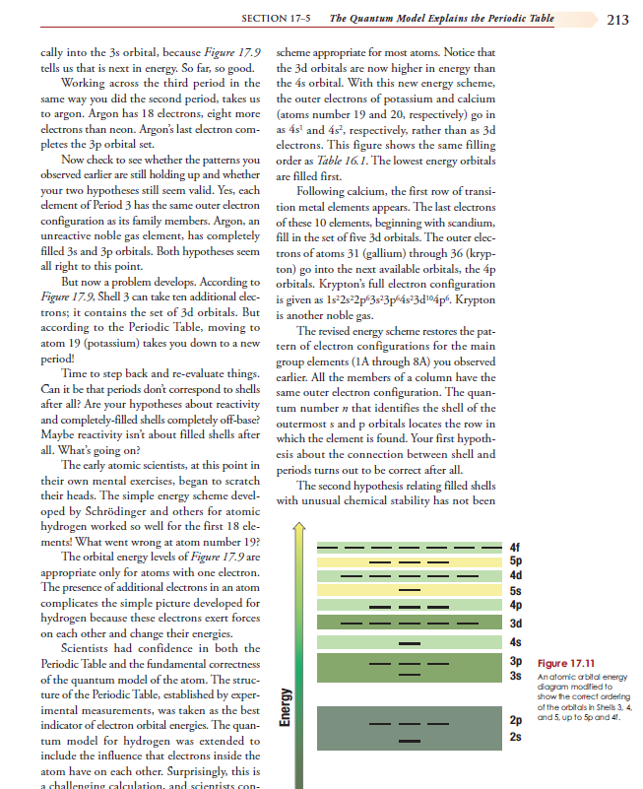
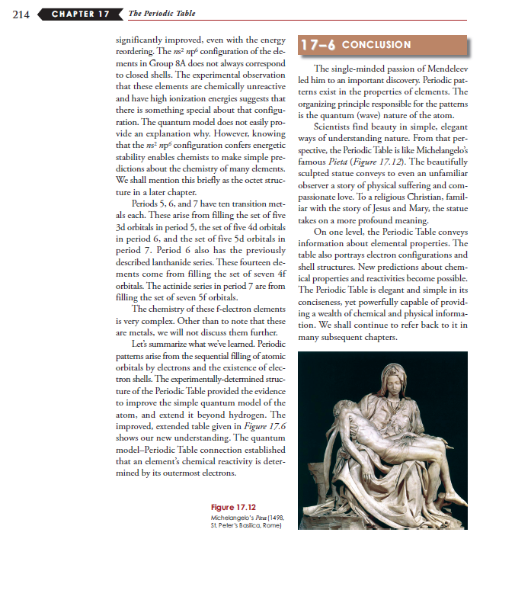
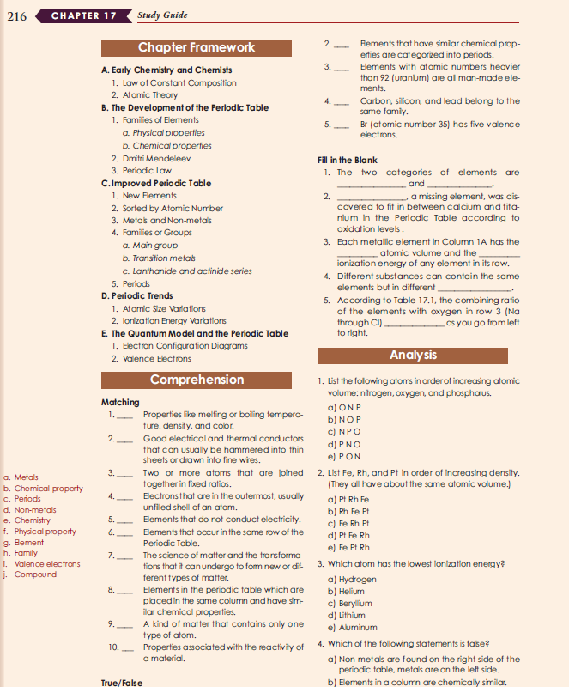
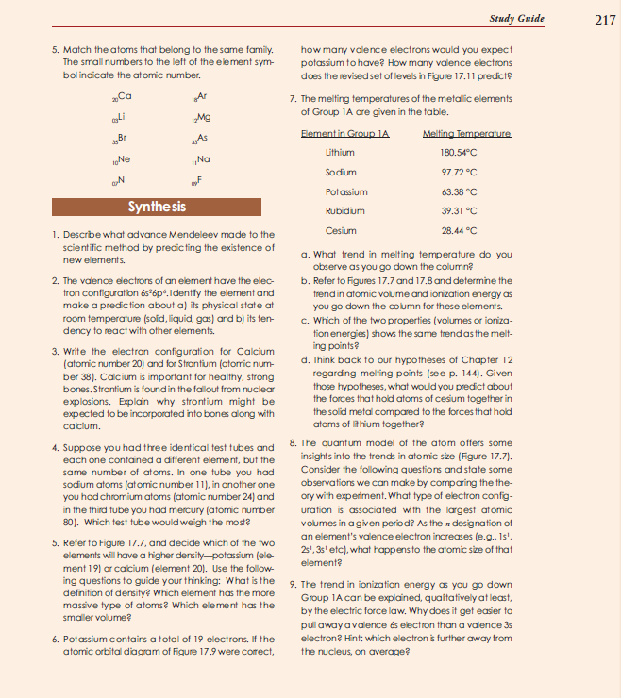
Before starting with KWL & The More You Know, I preview the chapter for structure using Skeleton.

Slide 11
I then do a T.H.I.E.V.V.E.S. with Snatches, but I do NOT set a purpose yet.

Slide 12
I am now ready to activate my prior knowledge, the K (What I Know) part of the strategy. Also I list what I think I know but am not sure—this gives me additional motivation to read to see if I know this or not and if my “knowledge” needs to be tweaked.

Slide 13
Here is what I know or think I know about the Periodic Table:
Feb 14
008
Chapter 17 “Periodic Table”
I studied the periodic table in 9th grade (Mr. Shaw’s class) but Uranium (92nd element) was the last element then. (I’m old.)
The atomic # is the # of protons and the # of neutrons combined (I think?)
The nucleus has protons and neutrons in it.
Electrons circle the nucleus. The number of electrons and protons are the same.
Ion has to do with the number of electrons out of balance with protons.
The protons and neutrons are made up of quarks. (But I ‘m fuzzy on what they are.)

Slide 14
Now I think what it is that I WANT and NEED to know.
I put that in the second BEFORE column. These questions will become my purposes and will guide my reading, a Launch.
I studied the periodic table in 9th grade (Mr. Shaw’s class) but Uranium (92nd element) was the last element then. (I’m old.)
The atomic # is the # of protons and the # of neutrons combined (I think?)
The nucleus has protons and neutrons in it.
Electrons circle the nucleus. The number of electrons and protons are the same.
Ion has to do with the number of electrons out of balance with protons.
The protons and neutrons are made up of quarks. (But I ‘m fuzzy on what they are.)
Wow! I’m on a roll. I need more room to list my questions BEFORE I even start reading. I am very curious to know the answers to these things.
How was the periodic table originally developed?
And by whom?
How were these elements identified, especially those since I was in 9th grade?
How is the periodic table organized? Why are the elements grouped as they are?
Is a proton a proton no matter the element? Same with neutrons and electron? That is, is only the number of the particles in an atom what distinguishes the elements, not the particles themselves?
Define and distinguish ions and ionization energy.

Slide 15
Now for the DURING portion of the strategy.
I am ready to read, having activated my prior knowledge and listed things I really want to learn from this text. I will be actively searching for answers to these questions as I read.
I studied the periodic table in 9th grade (Mr. Shaw’s class) but Uranium (92nd element) was the last element then. (I’m old.)
The atomic # is the # of protons and the # of neutrons combined (I think?)
The nucleus has protons and neutrons in it.
Electrons circle the nucleus. The number of electrons and protons are the same.
Ion has to do with the number of electrons out of balance with protons.
The protons and neutrons are made up of quarks. (But I ‘m fuzzy on what they are.)
How was the periodic table originally developed? And by whom?
How were these elements identified, especially those since I was in 9th grade?
How is the periodic table organized? Why are elements grouped as they are?
Is a proton a proton no matter the element? Same with neutrons and electrons? That is, is only the number of the particles in an atom what distinguishes the elements, not the particles themselves?
What is a quark?
Define and distinguish ions and ionization energy.

Slide 16
As I am reading, I realize there are concepts the author assumes I know, and I don’t. Some of these are becoming huge roadblocks to my understanding. I cannot move forward until I understand them. Here is where I WANT MORE than the text provides. I must search elsewhere—now.
I need to understand more concepts , too, but have run out of space on the ThinkSheet, so I will write my newly gained understanding in the margins of my text where I need to be reminded of the meaning. I could also write them on separate sheet or a study card. The important thing is that I now can continue to process the meaning of this text.
I studied the periodic table in 9th grade (Mr. Shaw’s class) but Uranium (92nd element) was the last element then. (I’m old.)
The atomic # is the # of protons and the # of neutrons combined (I think?)
The nucleus has protons and neutrons in it.
Electrons circle the nucleus. The number of electrons and protons are the same.
Ion has to do with the number of electrons out of balance with protons.
The protons and neutrons are made up of quarks. (But I ‘m fuzzy on what they are.)
How was the periodic table originally developed? And by whom?
How were these elements identified, especially those since I was in 9th grade?
How is the periodic table organized? Why are elements grouped as they are?
Is a proton a proton no matter the element? Same with neutrons and electrons? That is, is only the number of the particles in an atom what distinguishes the elements, not the particles themselves?
What is a quark?
Define and distinguish ions and ionization energy.
What is the quantum model of the atom? I started searching this same text.
Duh!, This is in Chapter 16 that I should have learned well but didn’t. Now I re-study parts of Chpt. 16, this time with engagement.

Slide 17
I continue reading
with my mind highly alert
to answer to my questions and
to learn new things.
When unexplained concepts hit and become roadblocks, I pause and BUILD SCHEMA. This is easy these days with the Internet, Scholar Google, even Wikipedia, and can be so interesting that I must force myself away from these side-trips. I need to grab just the info needed, so I can
return quickly to my text with the concepts clarified.
Notes:
Take out Wikipedia – put World Book Encyclopedia

Slide 18
When I finish the chapter, I list what I learned.
I studied the periodic table in 9th grade (Mr. Shaw’s class) but Uranium (92nd element) was the last element then. (I’m old.)
The atomic # is the # of protons and the # of neutrons combined (I think?)
The nucleus has protons and neutrons in it.
Electrons circle the nucleus. The number of electrons and protons are the same.
Ion has to do with the number of electrons out of balance with protons.
The protons and neutrons are made up of quarks. (But I ‘m fuzzy on what they are.)
Mendeleev, of Russia, used cards to sort until he discovered the patterns. In 1861 – the first Periodic Table with 50 elements. Today 111 elements. Evolving
In doing so, I also realize some big gaps still exist in my understanding.
Because I really want to learn the Periodic Table thoroughly, I move to the AFTER W-M column.
I see right away that I learned much more than
I have room to list in the L column. So, I look at my questions in the W-N column and rehearse the answers in my mind or on a separate sheet. I also read over my prior knowledge column, the K column, and explain to myself the clarifications and enhanced understanding I have come to.
How was the periodic table originally developed? And by whom?
How were these elements identified, especially those since I was in 9th grade?
How is the periodic table organized? Why are elements grouped as they are?
Is a proton a proton no matter the element? Same with neutrons and electrons? That is, is only the number of the particles in an atom what distinguishes the elements, not the particles themselves?
What is a quark?
Define and distinguish ions and ionization energy.
Every mark on the table, where the element is placed, & its color means something that shows relationships among the elements.
What is the quantum model of the atom?
I started searching this same text.
Ah, this is in Chapter 16 that I should have learned well but didn’t. Now I re-study parts of Chpt. 16, this time with engagement.

Slide 19
For the second question, I went into the search a bit cocky, having learned so much from my previous
experiences. Yet, I went ahead and studied an extended article in the Encyclopedia Britannica and took a tutorial from Khan’s Academy.
Wow! Both experiences humbled me quickly. They certainly muddied the waters again about the complex and fascinating Periodic Table, but they also made me realize what a masterful table it is, that it was inspired by the natural world’s order—Mendeleev didn’t create the table, he discovered it! I have much more to learn!.
Of the many things I could ask, I selected two key questions to build schema beyond what the text provides.
For my first question, no matter what I did, I could not understand this paragraph. I think if I could, I would understand the essence of Chapter 17. Nothing in the text helped me, including all the previous 16 chapters. First, I poured over it again and again, reading the paragraph in context and by itself., guessing , reasoning. No luck—did I ever feel dumb! But I would not accept my lack of understanding. I am not dumb! I was determined. Then, I did a very helpful thing. I went to the chemistry lab where two different tutors worked with me one after the other. They were impressed that I had come with such targeted questions. Hearing two different people explain it in different ways finally helped me rip through the cloud of confusion.
Viola! I GET IT!!
I studied the periodic table in 9th grade (Mr. Shaw’s class) but Uranium (92nd element) was the last element then. (I’m old.)
The atomic # is the # of protons and the # of neutrons combined (I think?)
The nucleus has protons and neutrons in it.
Electrons circle the nucleus. The number of electrons and protons are the same.
Ion has to do with the number of electrons out of balance with protons.
The protons and neutrons are made up of quarks. (But I ‘m fuzzy on what they are.)
How was the periodic table originally developed? And by whom?
How were these elements identified, especially those since I was in 9th grade?
How is the periodic table organized? Why are elements grouped as they are?
Is a proton a proton no matter the element? Same with neutrons and electrons? That is, is only the number of the particles in an atom what distinguishes the elements, not the particles themselves?
What is a quark?
Define and distinguish ions and ionization energy.
Mendeleev, of Russia, used cards to sort until he discovered the patterns. In 1861 – the first Periodic Table with 50 elements. Today 111 elements. Evolving .
Every mark on the table, where the element is placed, & its color means something that shows relationships among the elements.
What is the quantum model of the atom?
I started searching this same text.
Ah, this is in Chapter 16 that I should have learned well but didn’t. Now I re-study parts of Chpt. 16, this time with engagement.
What is the meaning of the 2nd para , column 1, on last page?
What more is there to learn about the Periodic Table?

Slide 20
Now, it’s your turn to practice!
You do not need to go into as much depth as I did, but do DEMAND understanding of yourself and the author to the degree needed to meet your purposes.
Do all the steps for a very rewarding learning experience.

