Slide 1
Probe Author’s Mind
Demo

Slide 2
In the Handbook you read that this strategy is usually for texts presenting arguments, new propositions, and viewpoints such as in the social sciences, humanities, business, and essays.
Probe the Author’s Mind
helps you read more critically.
It provokes you to think like
a SCHOLAR.
Before going on, study the pages in the Handbook about Expand Critical Perspective and the critical reading strategy
Probe the Author’s Mind.
Keep that in mind when deciding whether or not to use this strategy.
Welcome to the DEMO for
Probe Author’s Mind.
Within Layered Reading this is an AFTER strategy.
Notes:
. by helping you . . .
Look for the author’s underlying meanings and assumptions,
Perceive the author’s biases or central claims,
Ponder the message’s implications,
Unpack the author’s arguments and evaluate them.

Slide 3
It has four sets of questions that will make you think deeply about a text:
What the author means.
Where the author is coming from.
What the social-political implications are of the messages.
Should the author’s message be accepted—meaning you evaluate the author’s claims, arguments, and messages.
You will not answer all the questions within each set,
just the ones that intrigue you and help you achieve your purposes for reading within the time you have.
Since this is a scholarly strategy, this ThinkSheet is more involved than others, as you can see.

Slide 4
I have chosen an article you have encountered in two previous demonstrations.

Slide 5
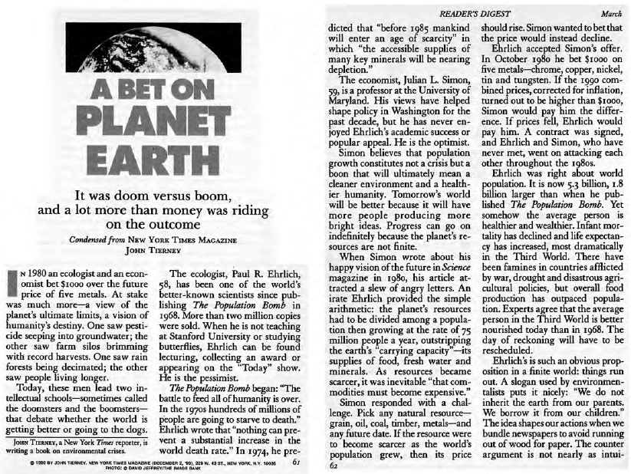
John Tierney is the author we are going to probe.
Look familiar?

Slide 6
This demonstration will not make sense
if you did not read and understand
the article earlier.
If you have not read it,
read it now before going on.
For your convenience, it is found on the last two slides of this demonstration.

Slide 7
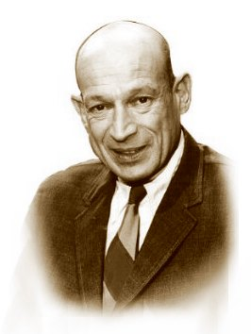
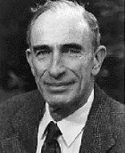
Here are the two men discussed in the article.
&
Dr. Paul L. Ehrlich, biologist
Dr. Julian Simons, economist
The Doomster
The Boomster

Slide 8
Hopefully you have read the article and have a good idea about its meaning.
Let’s now return to the ThinkSheet and work through this important AFTER strategy.

Slide 9
It can be difficult to differentiate between understanding an author’s point and agreeing/disagreeing with his or her point, but we must do this.
Do the fair thing:
Try hard to understand what the author is saying before judging the message.
Let me emphasize this point:
Have intellectual etiquette.
Read this instruction before beginning.

Slide 10
Let’s look at the Section 1 of the ThinkSheet.

Slide 11
Let’s read through each of these questions under 1. What does the author say in this text?

Slide 12
See how I completed the ThinkSheet.
JT shows both arguments (Ehlich’s & Simon’s) about whether the earth is in a peril or not. JT provides a history of “the bet”—how started, the arguments, reactions of others, the outcome, and their own reactions to it.
Without directly saying so, JT believes Simon: Humans adapt and innovate to overcome crises. JT gives subtle hints that he agrees—wrote more paragraphs & gave more evidence for Simon’s arguments, let his article be in Reader’s Digest, a conservative–leaning publication.

Slide 13
Read through each of these questions under 2. Where is this author coming from?

Slide 14
I will attempt to answer a couple of these questions as I try to understand where the author is coming from.

Slide 15
Notice that I state my answers for you, but that my answers on the ThinkSheet are abbreviated—just enough so I can remember later when I see what I wrote.
I think Tierney wants to subtly expose what he believes to be the fallacy of Ehrlich’s argument and the superiority of Simon’s argument hoping I will follow his “objective” presentation and will come to the same conclusion.
the fallacy of Ehrlich’s argument & superiority of Simon’s.

Slide 16
Ehrlich argues that overpopulation will stretch the resources of the planet so thin that dramatic increases in starvation will occur arguing for limits on family size, but Tierney’s central claim seems to be that the overarching evidence is not on Ehrlich’s side and that human innovation will solve the problem of dwindling resources. He gives a good portion of the article supporting Simon’s argument.
1. History supports Simon’s claim. 2. Gives more space to Simon’s opposing reasons and evidence.

Slide 17
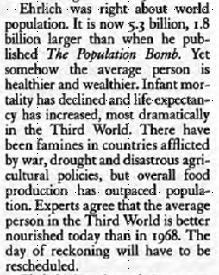
The point here is that the Tierney never explicitly states his point of view, but through this technique it becomes clear who’s side he is on.
. . . shares Simon’s counter point.
The Author does this a couple of times, but does not return the favor to Ehrlich anywhere else in the article.
He shares Ehrlich’s point of view and then
Notice that the author supports a basic aspect of Ehrlich’s point.
For example:
Then he states what he terms as a fact which discounts Ehrlich’s earlier point.
This is hard to say . . .
Tierney does do something interesting . . .
Finally, he states as fact something that supports Simon’s point of view.

Slide 18
See how I said all that thinking on my ThinkSheet.
Wants to appear “objective,” but isn’t—has conservative bias: not a balanced discussion, counters Ehrlich but not Simon.

Slide 19
Now we will go to Section 3:
What are the social-political implications of this text?

Slide 20
Lots of choices here; remember, you do not have to answer everyone.
Please read through all eleven questions now.
. . . but you should become familiar with what is being asked.

Slide 21
The consequences of accepting this human ingenuity view might be along a continuum from:
Nothing to worry about—no crisis: “Things will work out naturally” and then do nothing about the problems.
to
“Let’s get busy and solve this crisis. Let’s bring in the best minds, collaborate, and work hard to solve this problem. We humans can invent ways to solve this.”
which may improve the economy, at least in the short time,
Fewer resources might be poured into environmentalist causes,
Whatever else,
the future of the Earth’s natural resources affects everyone and will probably remain a hotly contested issue.
. . . and may impact the environment negatively, in the long term.
This text is a call
for human problem-solving, ingenuity, and exploring possibilities.
As before, I will go through a few of them.
This message makes us
feel good:
We humans can fix the problems of the world.
With Simon’s view: improved economy, environment need not be in peril—with human ingenuity;
remains hot issue.

Slide 22
If it purports to share the facts about an issue in a balanced way,
. . . it is one sided.
. . . then it would probably live up to that billing.
It depends on what the text is trying to be.
If it purports to support one side,
This seems misleading to present both sides from a seemingly objective, impartial stance if he actually wants to argue for one side over the other.
Since Tierney does not make his purpose clear (perhaps intentionally), readers may not realize they are being swayed toward Simon’s view.
Depends. Fair if purpose is to support Simon’s view—but not upfront about that. Unfair if he wants to appear balanced—he does not cover Ehrlich’s views as well as he does Simon’s. Deceptive in not making clear his purposes to the non-critical reader.

Slide 23
Now we will go to the
Section 4 wherein we evaluate the quality of the author’s messages:
“Should this author’s message be accepted?

Slide 24
A multitude of questions are needed because of the many ways you can approach evaluating an author’s arguments.
Once again, become familiar with the questions.
And you thought Section 3 had a lot of questions!
Please read through the 17 questions—and also the sub-questions of each.

Slide 25
I do only a few of these questions for any one text, so I select the most relevant for my purposes.
My original purposes for “A Bet on Planet Earth”:
Explain both arguments with JT’s evidence, and
decide which argument is more convincing and why?
Watch me do a few of the one’s I find useful for deciding which argument is more convincing and why in Tierney’s text.

Slide 26
I am not yet ready to conclude that Ehrlich is wrong. I recognize that Tierney has inadequately explored Ehrlich’s premise.
. . . is not well-supported.
I admit I am leaning toward accepting Simon’s premise because of my conservative ilk but not because of a balanced consideration of both sides.
It is much easier
for me, the reader, to accept Simon’s the human ingenuity premise because of all the arguments given,
but . . .
The implied premise that environmentalists like Ehrlich do not base their conclusions on fact . . .
The stated premise – about human ingenuity –
appears to be well supported by the historical examples.
Simon’s premise that human ingenuity can solve the problems seems true—lots of evidence,.
But I can’t accept JT’s implied conclusion that we should dismiss Ehlich’s premise that human overpopulation is a major cause of the problems—not explored enough.

Slide 27
But also today, whole groups of people dismiss both arguments and say that global warming and overpopulation is an unfortunate myth for which we are spending way too much time and money.
The Simon camp voices of today may be the ones encouraging innovators to develop alternative fuels, to find ways to reduce the carbon footprint, to create more earth-friendly ways to use the resources we have, and to search for or invent new resources to serve the same human needs (as Simon found in his study of the crises of history).
Yes, multiple views are being proposed with seemingly as many positions about how to preserve the planet as there are scientists, politicians, and folks like me.
Yes, this issue is very relevant today, probably more than when Tierney wrote the article.
Today, the Ehlich camp seems to be supported by massive evidence from scientists studying global warming.
The controversy over how to solve
the problem of resources is definitely worth our attention because of the threat (real or perceived) of global warming, food shortages, rampant new diseases, burgeoning human population, the extinction of many species, etc.
Yes, much controversy!
An understatement, indeed.
YES, Important! Many conflicting sides. Tierney’s issue of the Earth’s resources still relevant. Governments, science, business trying to find solutions.—but very little agreement among the entities who could do something if agreements could be reached. FRUSTRATING for all.

Slide 28
Good luck with your practice in probing the author’s mind!
Hopefully, you get the idea.
The key is to get into the Author’s mind without projecting yourself too much into the fray.
These are just a sample of the probing questions you might use in your investigations.
That is very hard to do, so Probe My Mind is the next strategy. But for now. . .

Slide 29
Copy of “A Bet on Planet Earth” for those who have not read it previously.

